Slide 1



OCCASIONAL
BY FIERY FLAMINGOS
GROUP #16

Slide 2







PRODUCT REQUIREMENTS
Filter & Search
Event Creation
Export Calendar
Comments & Feedback
Event Recommendation
1

Slide 3


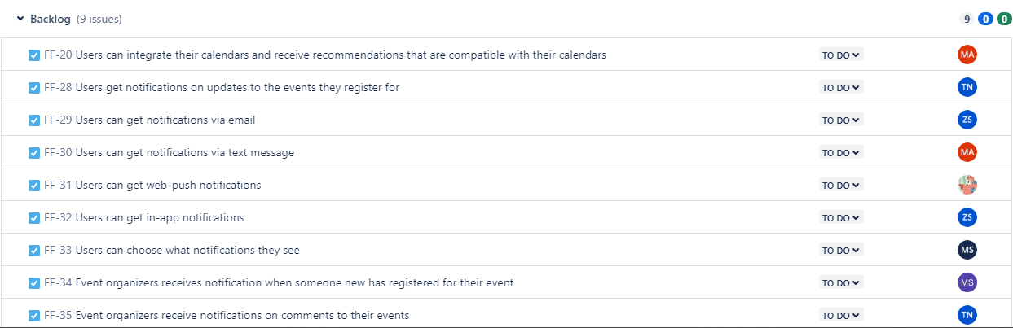
BACKLOG
Export & Share
Notifications & Alerts
2

Slide 4
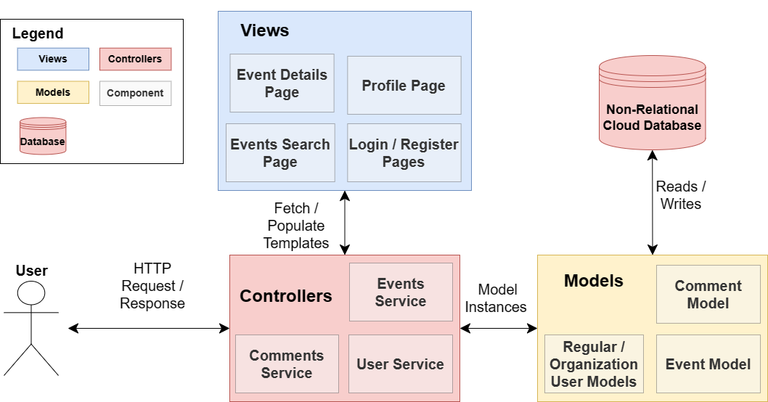
ARCHITECTURAL DESIGN
3

Slide 5

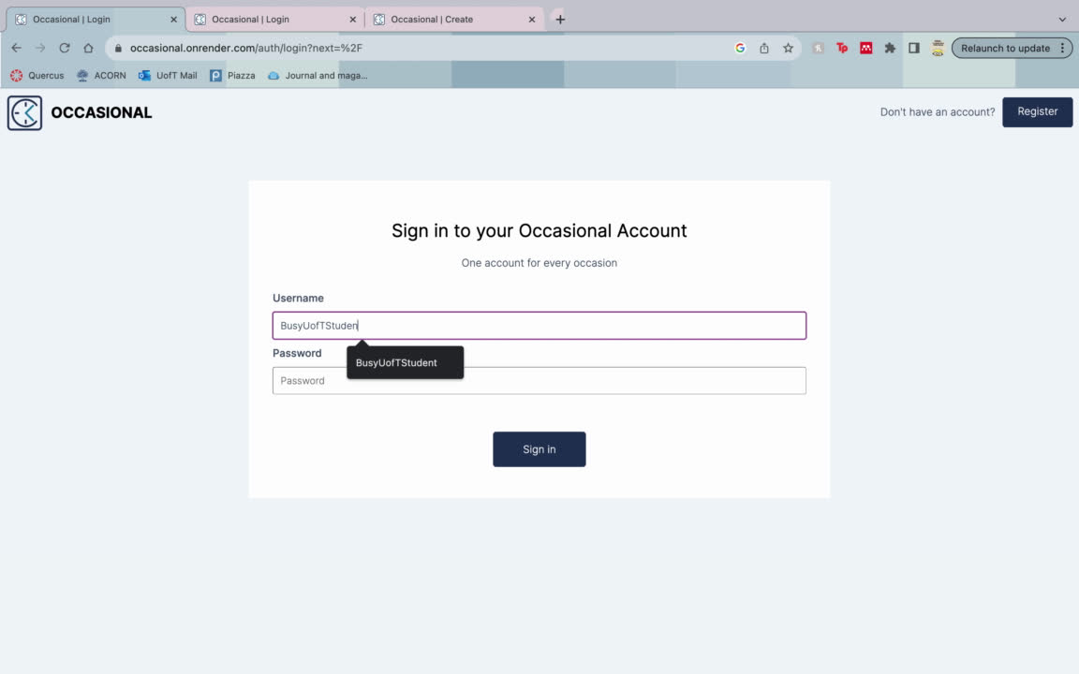
WALKTHROUGH - EVENT FILTERING
4

Slide 6





REFLECTION
TIME MANAGEMENT
SPRINT DEMARCATION
COMMUNICATION
5

Slide 7


THANKS FOR WATCHING
FIERY
FLAMINGOS

